Slide 1

Research Transparency
Maarten Voors
Wageningen

Slide 2
Disclaimer
Many from Garret Christensen, some slides from Macartan Humphreys (Research Fellow BITSS and Berkeley Institute for Data Science)
See also
Christensen (2016) Manual of Best Practices in Transparent Social Science Research
https://github.com/garretchristensen/BestPracticesManual
Miguel et al (2014) Promoting Transparency in Social Science Research. Science 03 Jan 2014:Vol. 343, Issue 6166, pp. 30-31DOI: 10.1126/science.1245317
Matthew Gentzkow Jesse M. Shapiro, Code and Data for the Social Sciences: A Practitioner’s Guide

Slide 3
Discuss
When you read a paper what are the things you look for to check of you believe the results?
Do you know colleagues who tried to manipulate results?

Slide 4

Dishonesty Happens
4
Notes:
Diederik Stapel
4

Slide 5
Why we worry
There are many claims and no evidence
Results not replicable
Results not stable
Results not credible
Results do not cumulate
Possibly especially true for social interventions

Slide 6
Many Possible Reasons
Bad Designs
Bad Analyses
Bad Reporting
Bad Promotion
Error and Fraud

Slide 7
What we find
Weak academic norms can distort the body of evidence.
Publication bias (“file drawer” problem)
p-hacking
Non-disclosure
Selective reporting
Failure to replicate

Slide 8
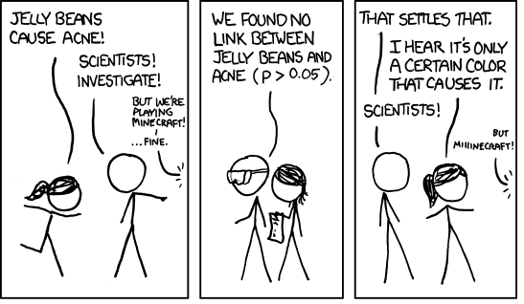

Slide 9
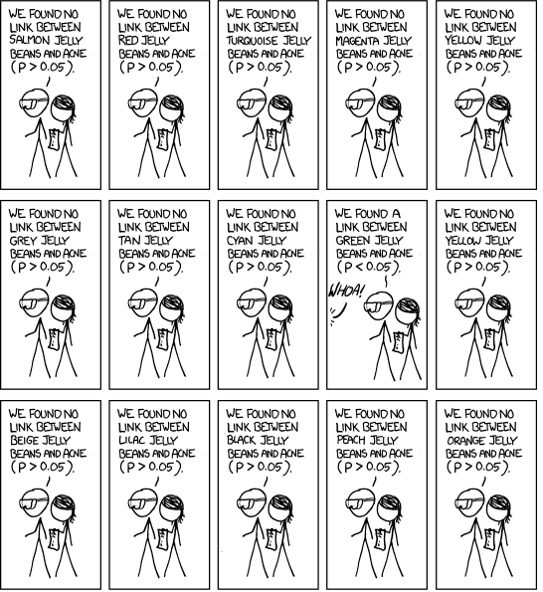

Slide 10
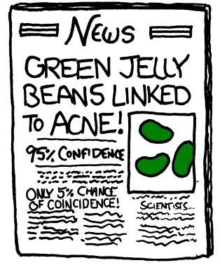
Credit: http://www.xkcd.com/

Slide 12
What is a p-value?

Slide 13
With what you know about p values…
If I run 100 regressions or ttests
How many should I expect to produce significant results at 5%?

Slide 14
Solution: Increasing transparency
Transparency is part of being an ethical researcher.
Scientific values espoused by Robert Merton (Merton 1942):
Universalism: anyone can make a claim regardless of status.
Communism: open sharing of knowledge.
Disinterestedness: truth as motivation, not financial (or other) gains.
Organized skepticism: peer review, replication.

Slide 15












Ecosystem for Open Science

Slide 16

Publication Bias
“File drawer problem”

Slide 17
Publication Bias
Status quo: Null results are not as “interesting.”
What if you find no relationship between a school intervention and test scores? (in a well-designed study…)
It’s less likely to get published, so null results are hidden.
How do we know? Rosenthal 1979:
Published: 3 published studies, all showing a positive effect…
Hidden: A few unpublished studies showing null effect
The significance of positive findings is now in question!

Slide 18
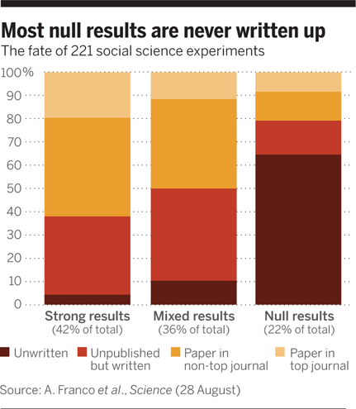
In social sciences…
Franco, Malhotra, Simonovits (2014)
Notes:
This is a study of researchers who received grants to work with a large, nationally representative data set. Here, the paper authors went back and surveyed all grantees. “Strong” results were 40pp more likely to be published, and 60pp more likely to be written up. The file drawer problem is large. (Franco, Malhotra, Simonovits 2014)

Slide 19
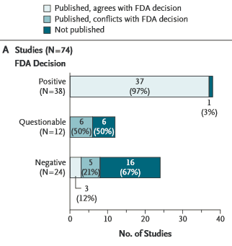
In medicine…
ClinicalTrials.gov
Turner et al. [2008]
Notes:
Publication rates of studies related to FDA-approved antidepressants. (See also Ioannidis [2008].) Nearly all trials with positive outcomes are published, a majority of negative-outcome studies were unpublished – all at four years after the study was completed.
Solution: clinicaltrials.gov
*Publicly state all research you will do, what hypotheses you will test, prospectively.
*Near universal adoption in medical RCTs. Numerous journals won’t publish if it’s not registered.
*Even better if registry requires outcomes from after study. Currently limited, but NIH is moving on this.

Slide 20
p-curves
Scientists want to test hypotheses
i.e. look for relationships among variables (schooling, test scores)
Observed relationships should be statistically significant
Minimize the likelihood that an observed relationship is actually a false discovery
Common norm: p-value < 0.05
But null results not “interesting” ...
So incentive is to look for (or report) the positive effects,
even if they’re false discoveries
Notes:
*Also called fishing, researcher degrees of freedom, or data-mining.

Slide 21
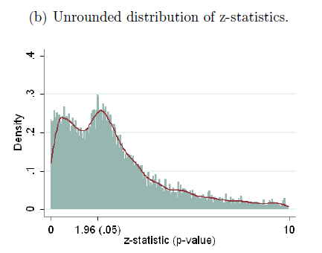
In economics…
Brodeur et al 2016. Data: 50,000 tests published in AER, JPE, QJE (2005-2011)
Turner et al. [2008]
Notes:
*Figure 1 shows a skewed distribution of p-values (which are used to determine the statistical significance of results) across various publications. There is a non-random increase in reported p-values just below 0.05 (a value commonly used as a threshold in the social sciences), suggesting researchers are tweaking data to verify hypotheses and increase the likelihood of publication (or else journal editors are discriminating against “barely not significant” estimates.)
This figure alone does not tell us if it is data mining that leads to the skewed results, or if researchers are honest but journal editor discriminate against “barely not significant” estimates. In fact this curve should bend in the opposite direction: there should be more outcomes with p-values above 0.05 – or, for a null effect, we should see a uniform distribution (flat line).
Using 50,000 tests published between 2005 and 2011 in the AER, JPE and QJE, we identify a residual in the distribution of tests that cannot be explained by selection. The distribution of p-values exhibits a camel shape with abundant p-values above :25, a valley between :25 and :10 and a bump slightly under :05. Missing tests are those which would have been accepted but close to being rejected (p-values between :25 and :10). We show that this pattern corresponds to a shift in the distribution of p-values: between 10% and 20% of marginally rejected tests are misallocated. Our interpretation is that researchers might be tempted to inflate the value of their tests by choosing the specification that provides the highest statistics.

Slide 22
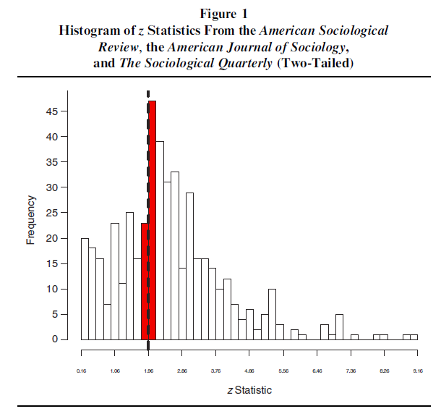
In sociology…
Gerber and Malhotra 2008

Slide 23
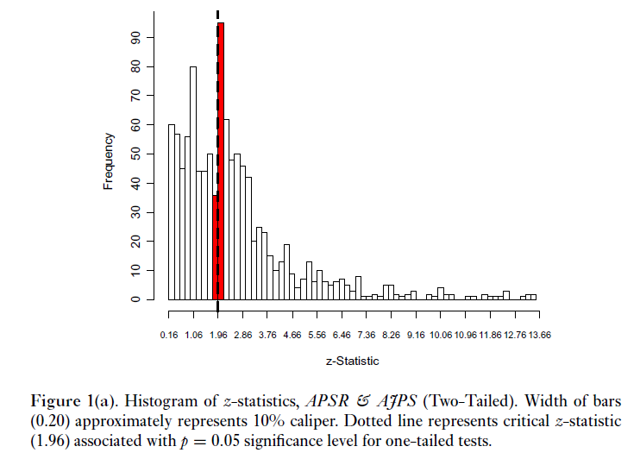
In political science…
Gerber and Malhotra 2008
Notes:
** Explain the x and y axes. Publication bias in political science. A 3-fold jump right at p=0.05.

Slide 24
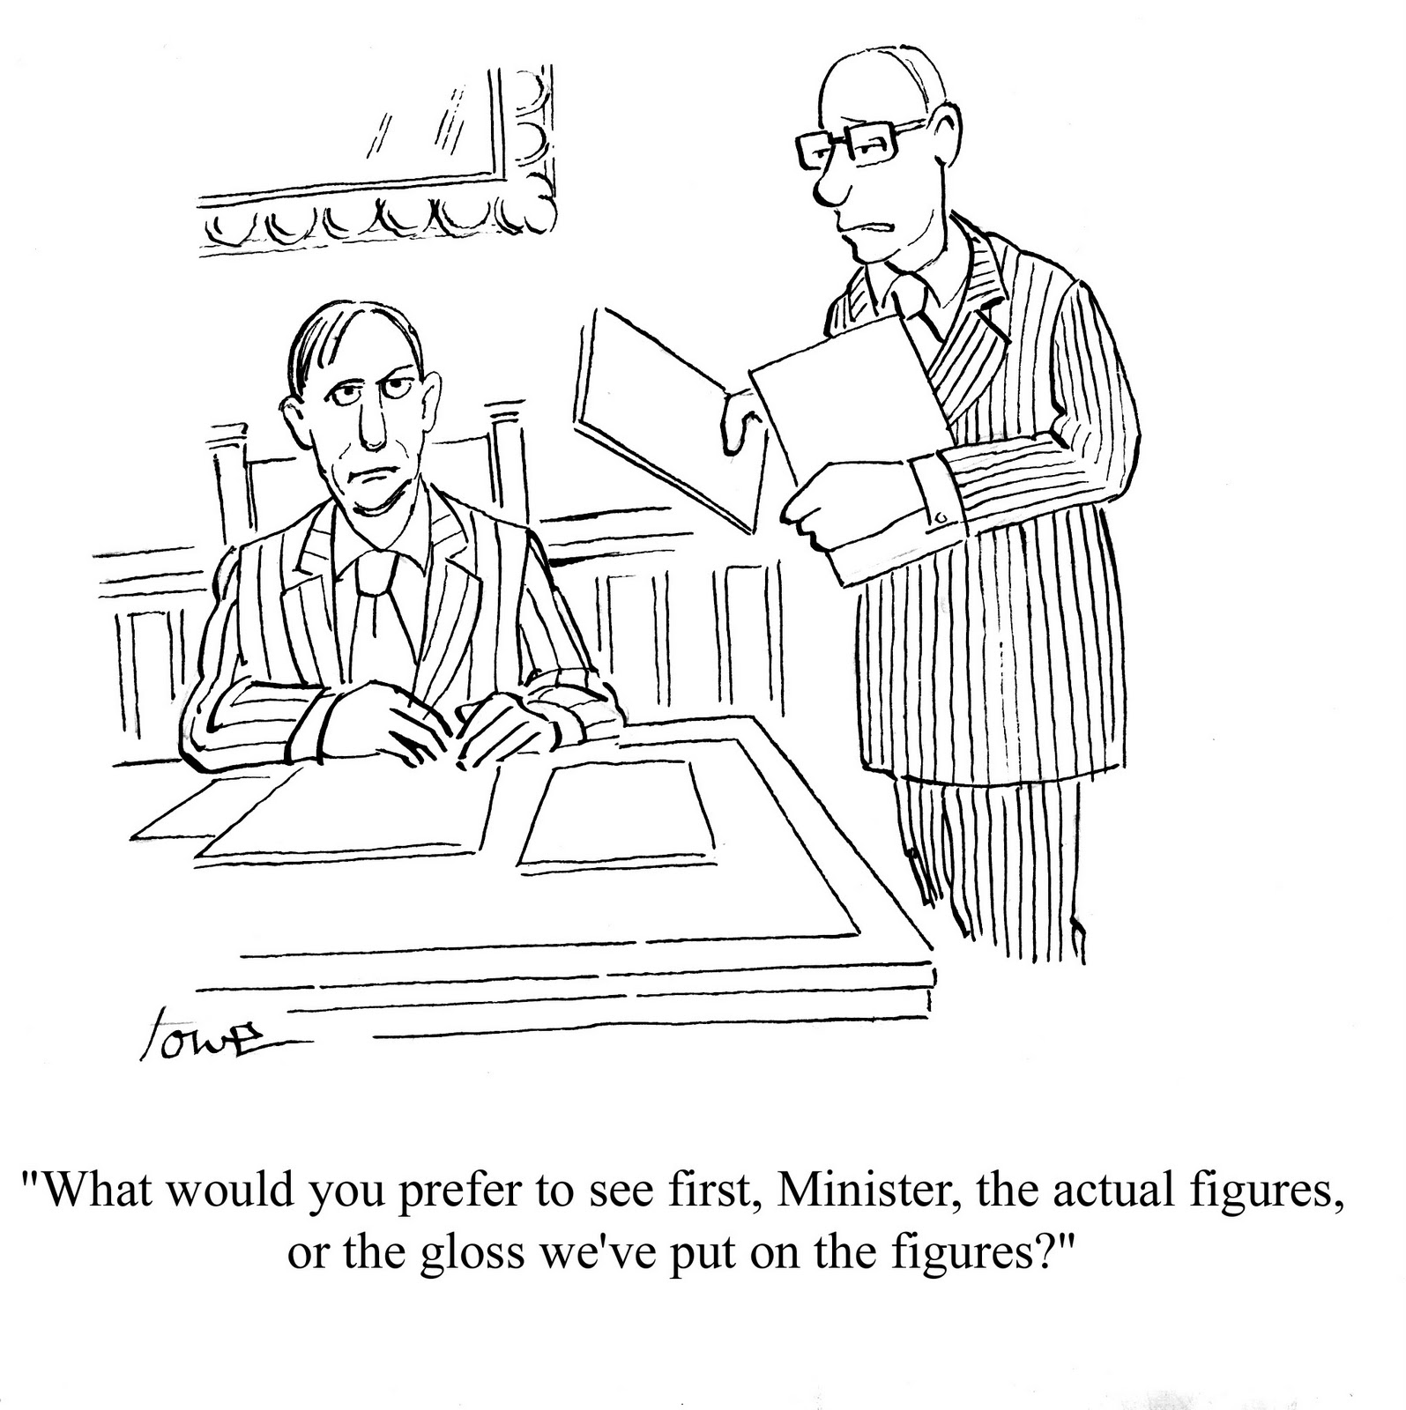

Slide 25
If we only write up/publish significant results, and we have no record of all the insignificant results, we have no way to tell if our ‘significant’ results are real, or if they’re the 5% we should expect due to noise.

Slide 26
Solution: Registries
Prospectively register hypotheses in a public database.
“Paper trail” to solve the “File Drawer” problem.
Differentiate confirmatory hypothesis testing from exploratory.
Medicine & Public Health: clinicaltrials.gov
Economics: AEA registry: socialscienceregistry.org
Political Science: EGAP Registry: http://egap.org/content/registration
Development: 3IE Registry: ridie.3ieimpact.org
Open Science Framework: http://osf.io
Notes:
New: easy-peasy pre-registration by Uri and the gang: http://aspredicted.org

Slide 27
Solution: Design Peer Review

Slide 28
Pre-registration
Have a look:
http://egap.org/content/registration
Very useful repository of possible designs

Slide 30
Non-disclosure
To evaluate the evidentiary quality of research, we need complete reporting of methods and results….
Challenge: limited real estate in journals
Challenge: heterogeneous reporting
Challenge: perverse incentives
It’s impossible to replicate or validate findings if methods are not disclosed.

Slide 31
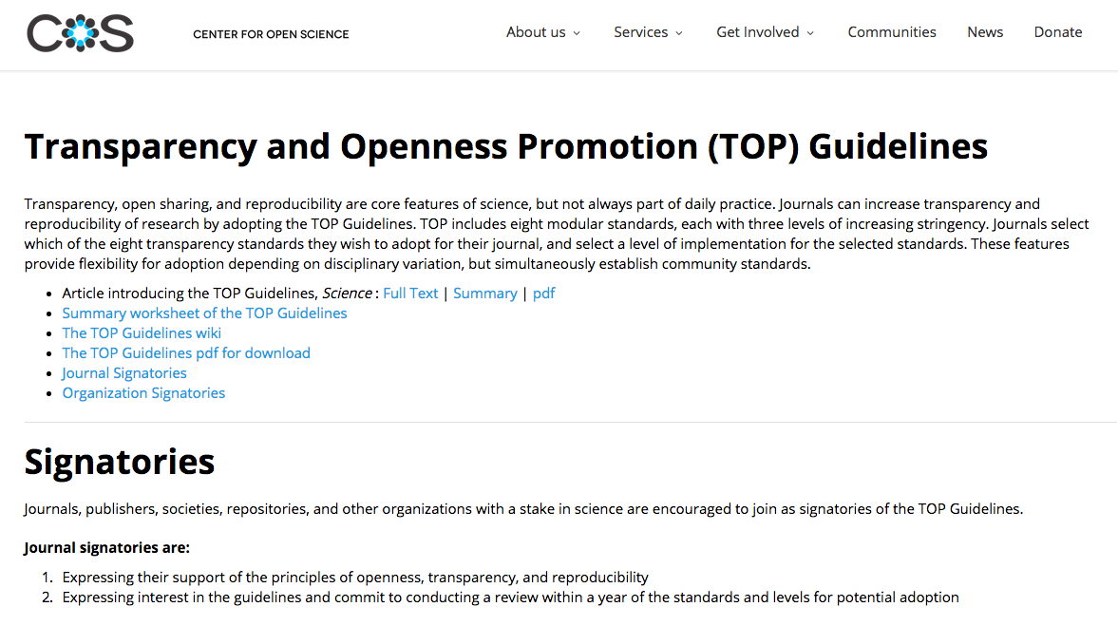
Solution: Standards
https://cos.io/top
Nosek et al, 2015 Science

Slide 32
Solution: Standards, Grass Roots Efforts
DA-RT Guidelines: http://dartstatement.org
Psych Science Guidelines: Checklists for reporting excluded data, manipulations, outcome measures, sample size. Inspired by grass-roots psychdisclosure.org.
21 word solution in Nelson, Simmons and Simonsohn (2012): “We report how we determined our sample size, all data exclusions (if any), all manipulations, and all measures in the study.”
Notes:
DART no longer counts as grass roots—adopted by APSA!

Slide 33
Selective Reporting
Problem: Cherry-picking & fishing for results
Can result from vested interests, perverse incentives…
You can tell many stories with any data set…
Example: Casey, Glennerster and Miguel (2012, QJE)
Notes:
** Explain the x and y axes. Publication bias in three of the leading general interest journals in economics This figure alone does not tell us if it is data mining that leads to the skewed results, or if researchers are honest but journal editor discriminate against “barely not significant” estimates.
-- Also mention that these findings of publication bias may only be the tip of the iceberg, once you think about all of the studies / results that are never published at all, never see the light of day. There is increasing evidence from the medical trial literature, where registration has been around for a while, that lots of registered studies never get published, or get published slower, and these delayed or vanishing studies are much more likely to have null results.
-- STAR WARS: THE EMPIRICS STRIKE BACK
Abel Brodeury Mathias Léz Marc Sangnierx Yanos Zylberberg{ June 2012
Abstract: Journals favor rejections of the null hypothesis. This selection upon results may distort the behavior of researchers. Using 50,000 tests published between 2005 and 2011 in the AER, JPE and QJE, we identify a residual in the distribution of tests that cannot be explained by selection. The distribution of p-values exhibits a camel shape with abundant p-values above :25, a valley between :25 and :10 and a bump slightly under :05. Missing tests are those which would have been accepted but close to being rejected (p-values between :25 and :10). We show that this pattern corresponds to a shift in the distribution of p-values: between 10% and 20% of marginally rejected tests
are misallocated. Our interpretation is that researchers might be tempted to inflate the value of their tests by choosing the specification that provides the
highest statistics. Note that Inflation is larger in articles where stars are used in order to highlight statistical significance and lower in articles with theoretical models.

Slide 35
Solution: Pre-specify
Define hypotheses
Identify all outcomes to be measured
Specify statistical models, techniques, tests (# obs, sub-group analyses, control variables, inclusion/exclusion rules, corrections, etc)
Notes:
** Explain the x and y axes. Publication bias in three of the leading general interest journals in economics This figure alone does not tell us if it is data mining that leads to the skewed results, or if researchers are honest but journal editor discriminate against “barely not significant” estimates.
-- Also mention that these findings of publication bias may only be the tip of the iceberg, once you think about all of the studies / results that are never published at all, never see the light of day. There is increasing evidence from the medical trial literature, where registration has been around for a while, that lots of registered studies never get published, or get published slower, and these delayed or vanishing studies are much more likely to have null results.
-- STAR WARS: THE EMPIRICS STRIKE BACK
Abel Brodeury Mathias Léz Marc Sangnierx Yanos Zylberberg{ June 2012
Abstract: Journals favor rejections of the null hypothesis. This selection upon results may distort the behavior of researchers. Using 50,000 tests published between 2005 and 2011 in the AER, JPE and QJE, we identify a residual in the distribution of tests that cannot be explained by selection. The distribution of p-values exhibits a camel shape with abundant p-values above :25, a valley between :25 and :10 and a bump slightly under :05. Missing tests are those which would have been accepted but close to being rejected (p-values between :25 and :10). We show that this pattern corresponds to a shift in the distribution of p-values: between 10% and 20% of marginally rejected tests
are misallocated. Our interpretation is that researchers might be tempted to inflate the value of their tests by choosing the specification that provides the
highest statistics. Note that Inflation is larger in articles where stars are used in order to highlight statistical significance and lower in articles with theoretical models.

Slide 36
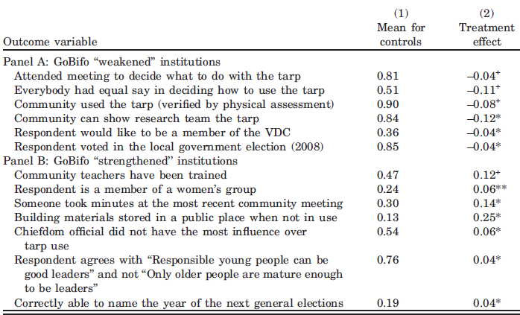
Reduce Cherry-Picking
Casey, Glennerster, Miguel (QJE 2012)
Notes:
Casey, Glennerster, Miguel (2012, QJE)

Slide 37
Failure to replicate
“Reproducibility is just collaboration with people you don’t know, including yourself next week”—Philip Stark, UC Berkeley
“Economists treat replication the way teenagers treat chastity - as an ideal to be professed but not to be practised.”—Daniel Hamermesh, UT Austin
http://www.psychologicalscience.org/index.php/replication

Slide 38
Why we care
Identifies fraud, human error
Confirms earlier findings (bolsters evidence base)

Slide 39
Solution: workflow
Data analysis is computer programming
Code everything that can be coded.
No data analyst is an island for long.
Code is communication
Map inputs to outputs
We should know where the data came from and what operations were performed on which set of data.
Version control prevents clobbering, reconciles history, and helps organize work.
No: inequalityMV4_APSRsubmit_reallyfinal2
Version control: Github, OSF
Testing minimizes error.
Work should be reproducible.
Integrate Coding, Rmarkdown,
Organise thoughts: simplenote
Research ought to be credible communication.
See Bouwers and Voors 2016 How to improve your relationship with your future self

Slide 40


Replication Resources
Replication Wiki:
http://replication.uni-goettingen.de/
Large-scale Replication Efforts
Reproducibility Project: Psychology
Many Labs
Notes:
Reproducibility Project: just on Planet Money recently, Show 677.

Slide 41

Replication Resources
Data/Code Repositories:
Dataverse (IQSS)
ICPSR
Open Science Framework
GitHub
New ICMJE Policy?
Jan 20, 2016
http://annals.org/article.aspx?articleid=2482115
Notes:
Reproducibility Project: just on Planet Money recently, Show 677.

Slide 42
Replication Standards
Replications need to be subject to rigorous peer review (no “second-tier” standards)
Could they be pre-registered as well?

Slide 43
Reproducibility
The Reproducibility Project: Psychology was a crowdsourced effort to estimate the reproducibility of a sample of 100 studies from the literature.
Science (Aug 28, 2015): “Ninety-seven percent of original studies had statistically significant results. Thirty-six percent of replications had statistically significant results; 47% of original effect sizes were in the 95% confidence interval of the replication effect size; 39% of effects were subjectively rated to have replicated the original result; and if no bias in original results is assumed, combining original and replication results left 68% with statistically significant effects.”
https://osf.io/ezcuj/

Slide 44
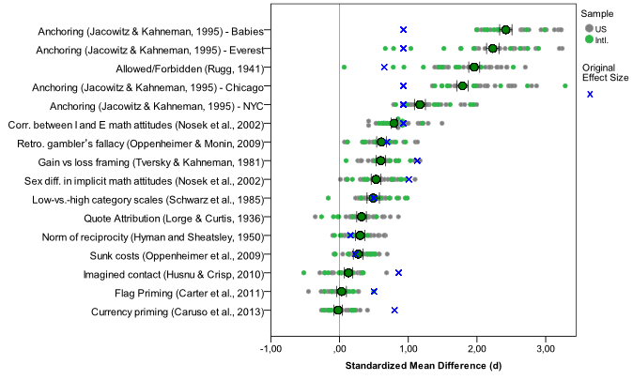
Many Labs
https://osf.io/wx7ck/

Slide 45
Some Solutions…
Why we worry…
Publication bias → Pre-registration
Non-disclosure → Reporting standards
P-hacking→ Pre-specification
Failure to replicate → Open data/materials, Many Labs

Slide 46
What does this mean?
In practice:
BEFORE
DURING
AFTER
Pre-register study and pre-specify hypotheses, protocols & analyses
Carry out pre-specified analyses; document process & pivots
Report all findings; disclose all analyses; share all data & materials

Slide 47



In practice:
Report everything another researcher would need to replicate your research:
Literate programming
Version control
Dynamic documents
Follow consensus reporting standards
Notes:
(1) Post your code and your data in a trusted public repository.
*Find the appropriate repository:
http://www.re3data.org/
*Repositories will last longer than your own website.
*Repositories are more easily searchable by other researchers.
*Repositories will store your data in a non-proprietary format that won’t become obsolete.
(2) Literate programming: write and command your code in a way that can be understood by humans, not only machines
(3) CONSORT for medical trials, not really in social science – but some good resources are being developed.

Slide 48
Efficient and Right

